Slide 1
Sociology: 3549 Hypothesis testing
Recitation #11
Yue Chu

Slide 2
announcement
Hope you’re all doing well!
Post-election resources on campus
OSU “Education for Citizenship Post-Election Dialogue Series” (more info is here)
“Unpacking the Presidential 2020 Election — How we got here and what lies ahead.”
Next: Nov. 10, 6-7:30 p.m. “Unpacking the 2020 Presidential Election — Can we talk?”
POST-ELECTION CONVERSATIONS WITH OTHER STUDENTS: A FEW IDEAS
OSU “Election 2020: Understanding the Outcome” – Nov.12, 4pm (more info here)
Homework 3 is due Nov.13
Make sure to show your work!

Slide 3
agenda
Review of lecture
Activity
T test and t distribution
CI with t distribution
Hypothesis testing
Single mean t test
Two means t test
In class exercise
Upload your answer to Carmen for today’s lab attendance

Slide 4

Hypothesis testing – Z-test
Hypothesis testing
H₀ (Null hypothesis): No statistically significant difference between the test population and hypothesized mean, or between two population means.
H₁ (or H_{a}, Alternative hypothesis): Statistically significant difference between the test population and hypothesized mean, or between two population means.
Compare $z_{\overline{x}}$ to critical value
What if we don’t know population SD - $σ$ ?
Notes:
Walrus

Slide 5
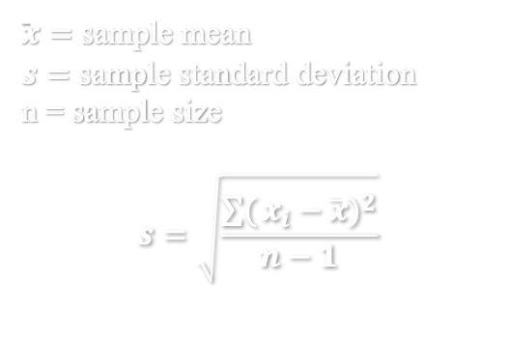

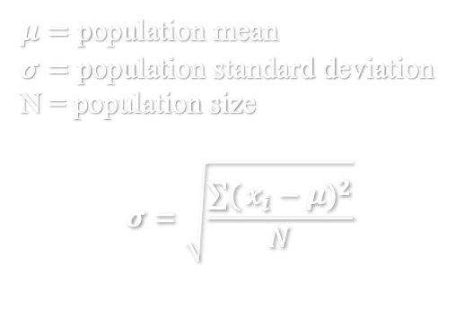



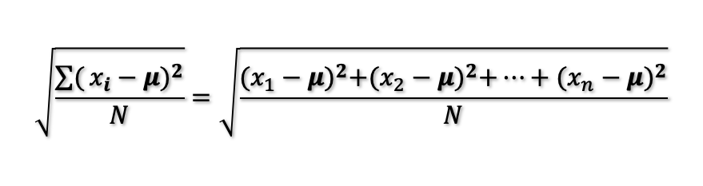
Z-test vs t-test
Estimated standard error based on population:
$z_{\overline{x}}=\frac{\overline{x}−μ}{σ/√n}$ follows a z-distribution
Estimated standard error based on sample:
$t_{\overline{x}}=\frac{\overline{x}−μ}{s/√n}$ follows a t-distribution
$${SE}_{\overline{x}}=\frac{σ}{√n}$$
$${SE}_{\overline{x}}=\frac{s}{√n}$$
$μ=$ population mean
$σ=$ population standard deviation
N = population size
$$σ=\sqrt{\frac{\sum{(}{x_{i}−μ)}^{2}}{N}}$$
$\overline{x}=$ sample mean
$s=$ sample standard deviation
n = sample size
$$s=\sqrt{\frac{\sum{(}{x_{i}−\overline{x})}^{2}}{n−1}}$$
$$\sqrt{\frac{\sum{(}{x_{i}−μ)}^{2}}{N}}=\sqrt{\frac{{(x_{1}−μ)}^{2}+{(x_{2}−μ)}^{2}+…+{(x_{n}−μ)}^{2}}{N}}$$
Notes:
Why subtract 1 in denominator when calculating sample SD : sample variance tends to be smaller for sample than for population, thus it underestimates amount of variability and we slightly decrease the denominator to adjust / “correct” for this potential underestimation.

Slide 6
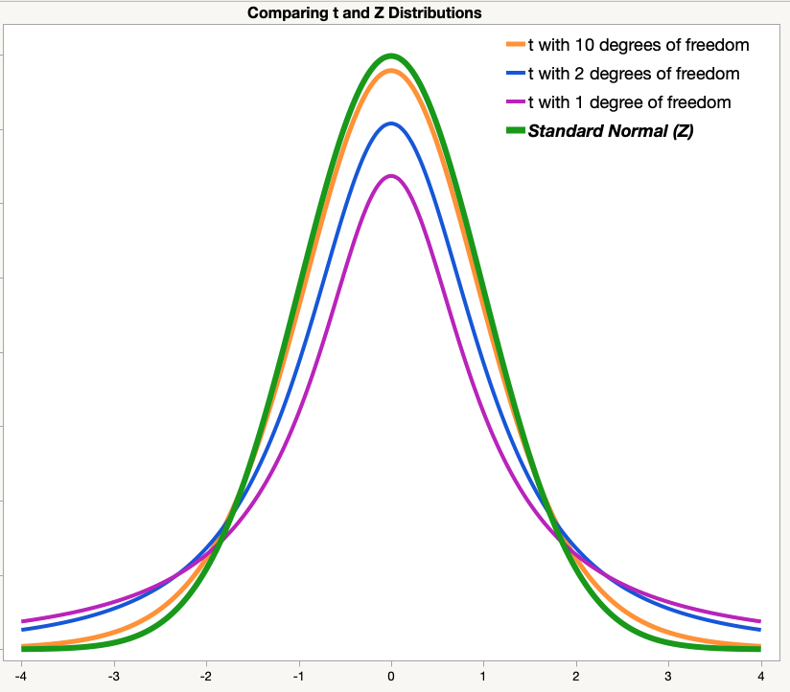
Z-distribution vs t-distribution
Degree of freedom: df = n-1
The degree of freedom refers to the number of independent observations in a dataset.
The degree of freedom is the number of values that are free to vary in a dataset.
As df → infinity, t-score → z-score
Notes:
Source:https://www.jmp.com/en_us/statistics-knowledge-portal/t-test/t-distribution.html

Slide 7

Which one to use? z-test vs t-test
Know population SD $σ$, do a z-test!
Only have sample SD $s$, do a t-test! (more common)
Using the estimated standard error that is based on the sample standard deviation requires us to use the t-distribution instead of the z-distribution to find the critical region under the normal curve.
Z tests are appropriate when the standard error is calculated using the population standard deviation while t is needed when the standard error is estimated using the sample standard deviation

Slide 8
Confidence interval
Based on sample SD

Slide 9



Confidence Interval with population SD (week 8)
Z-score with area above z being $α/2$on both tails
Determined by self-defined confidence level (1- $α$)
$$\overline{x}±z_{α/2}∙σ_{\overline{x}}$$
Sample mean
SE based on population SD
$$σ_{\overline{x}}=\frac{σ}{√n}$$
Interpretation
Based on our sample of size n, we are XX% confident that the true population mean is somewhere between <lower limit> and <upper limit>.

Slide 10



Confidence Interval with sample SD
t-score with n-1 degree of freedom and significance level $α$.
Determined by confidence level (1- $α$) and degree of freedom (n-1).
$$\overline{x}±t_{df,α}∙s_{\overline{x}}$$
Sample mean
SE based on sample SD
$$s_{\overline{x}}=\frac{s}{√n}$$
Interpretation
Based on our sample of size n, we are XX% confident that the true population mean is somewhere between <lower limit> and <upper limit>.

Slide 11
Hypothesis testing
Single mean t-test
Two means t-test

Slide 12
Steps for test hypothesis
State
State hypothesis (H₀ vs H₁)
Sig.
Calculate
Collect sample and compute test statistics
Decide
whether reject / fail to reject H₀
Know population SD, use z-test. Don't know population SD, use t-test.
Set significance level ($α$), decide critical values & critical region
Set significance level (𝜶), decide critical values & critical region
Know population SD, use z-distribution. Only know sample SD, use t-distribution.

Slide 13
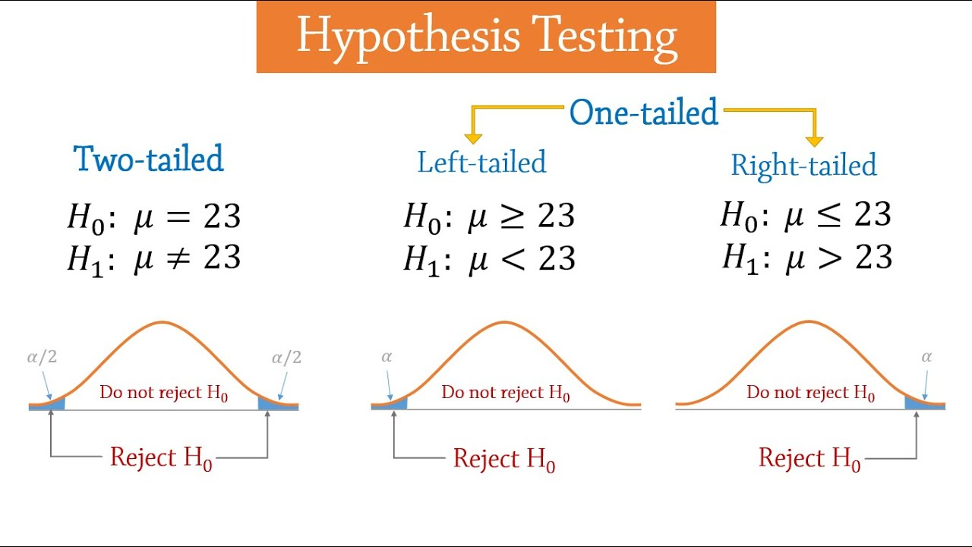
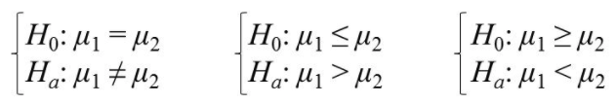
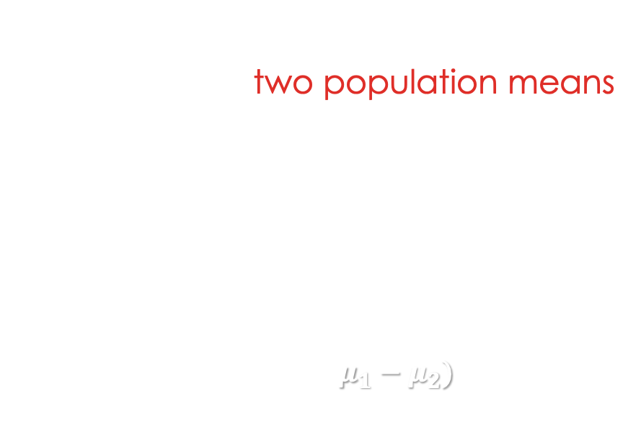
How to set h₀
 | Two-tailed | Left-tailed | Right-tailed
H₀ | Equal | No less than | No greater than
H₁ | Not equal | Less than | Greater than
Single mean test
test population mean in relation to a hypothesized mean.
Two means test
test whether two population means differ.
Essentially testing ($μ_{1}−μ_{2})$ in relation to hypothesized value 0
includes equality

Slide 14
Underlying assumptions for two-means t-test
Two means test: test whether two population means differ.
Underlying assumptions
Two sampled populations are normal distributions.
Two sampled populations have equal variances.
Cases in the samples are independent.
Notes:
includes equality

Slide 15

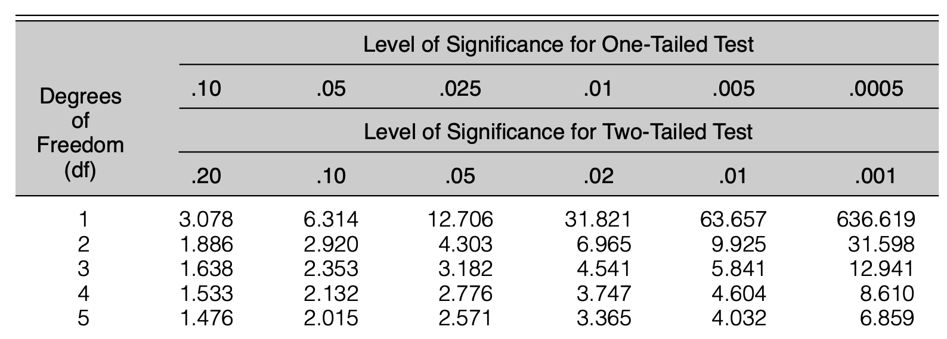


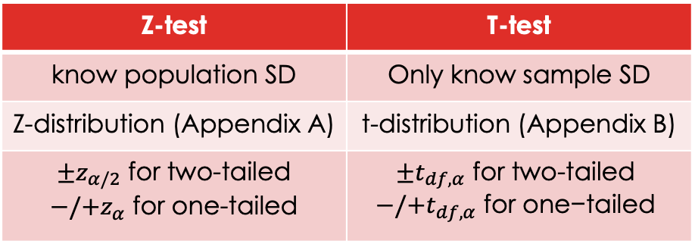
Critical region
Z-test | T-test
know population SD | Only know sample SD
Z-distribution (Appendix A) | t-distribution (Appendix B)
${±z}_{α/2}$ for two-tailed $−/{+z}_{α}$ for one-tailed | ${±t}_{df,α} \text{for} \text{two}\text{−}\text{tailed}$ $$−/+t_{df,α} \text{for} \text{one}\text{−}\text{tailed}$$
Set significance level $α$.
Determine z-test or t-test.
One-tailed vs two-tailed test.
Degree of freedom
Single-mean: $df=\left(n−1\right)$
Two-means: $df=\left(n_{1}−1\right)+(n_{2}−1)$
Find critical value(s)
$t_{df,α}$ is row with df, column with sig. level $α$ given one-/two-tailed test.

Slide 16
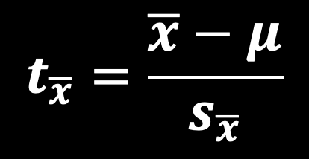
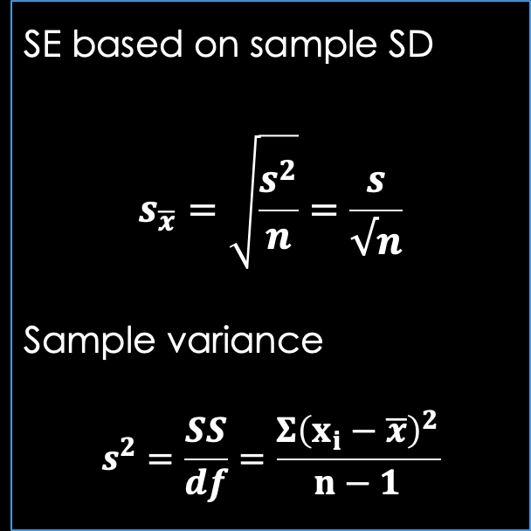
Compute t-score: single-mean t-test
Compare test statistics $t$-score to critical value ($t_{df,α}$)
Single mean t-test
t-score is calculated by:
SE based on sample SD
$$s_{\overline{x}}=\sqrt{\frac{s^{2}}{n}}=\frac{s}{√n}$$
Sample variance
$$s^{2}=\frac{SS}{df}=\frac{Σ{\left(x_{i}−\overline{x}\right)}^{2}}{n−1}$$
$$t_{\overline{x}}=\frac{\overline{x}−μ}{s_{\overline{x}}}$$

Slide 17
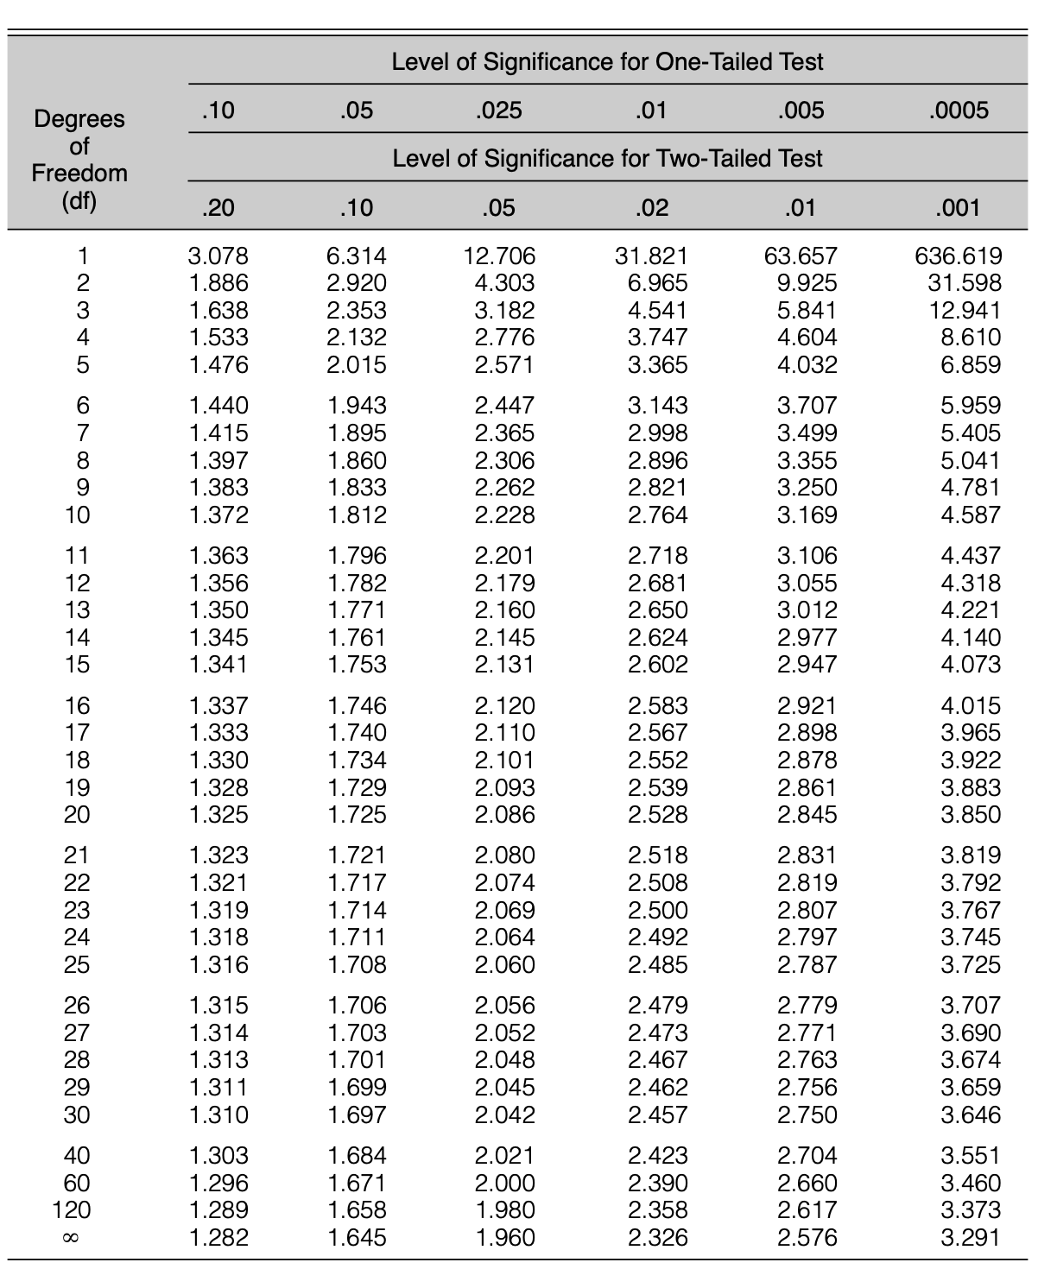


EXAMPLE 1 – SINGLE MEAN T-TEST
Birth weight example: Whether mean birth weight has dropped comparing to 2000.(mean=3.4 kg) A sample n=40, mean $\overline{x}$=3.35 kg, SD s=0.19
H₀: $μ ≥3.4$ kg vs H₁: $μ<3.4$ kg. ← One-tail test, left-tailed
Only know sample SD, we do a t-test
Degree of freedom n-1=39, critical value ${t_{critical}=−t}_{39,0.05}$= -1.684
t-score for sample mean: $t_{\overline{x}}=\frac{\overline{x}−μ}{s/√n}=\frac{3.35−3.4}{0.19/√40}$= -1.664
$t_{\overline{x}}>t_{critical}$ , does not fall in critical region.
Based on the sample of 40 girls, at 0.05 significance level we fail to reject the null hypothesis that mean birth weight $μ ≥3.4$ kg.
No sufficient evidence to say MBW has dropped comparing to 2000.
Statement
Sig. level
Calculate
Decide

Slide 18


EXAMPLE 2 – SINGLE MEAN T-TEST
Birth weight example: Whether mean birth weight has dropped comparing to 2000.(mean=3.4 kg) A sample n=400, mean $\overline{x}$=3.35 kg, SD s=0.19
H₀: $μ ≥3.4$ kg vs H₁: $μ<3.4$ kg. ← Left-tailed t-test
Degree of freedom n-1=399, critical value ${t_{critical}=−t}_{399,0.05}$= -1.645
t-score for sample mean: $t_{\overline{x}}=\frac{\overline{x}−μ}{s/√n}=$-1.664 $<t_{critical}$ , in critical region.
Increased sample size, everything else remains the same, we now reject the null hypothesis.
↑ n, ↓ SE, ↓ abs($t_{critical}$), more likely to reject, sample provides more info about given population, sample statistics more accurately approximate population parameters.
Statement
Sig. level
Calculate
Decide
Notes:
When sample size increases, standard error decreases. So for the same sample mean, its relative distance to population mean increases and becomes more likely to fall into critical region.
Will prefer conclusion from the second scenario because the bigger sample size, more information we have about given population, so sample statistics will more accurately approximate population parameters.

Slide 19
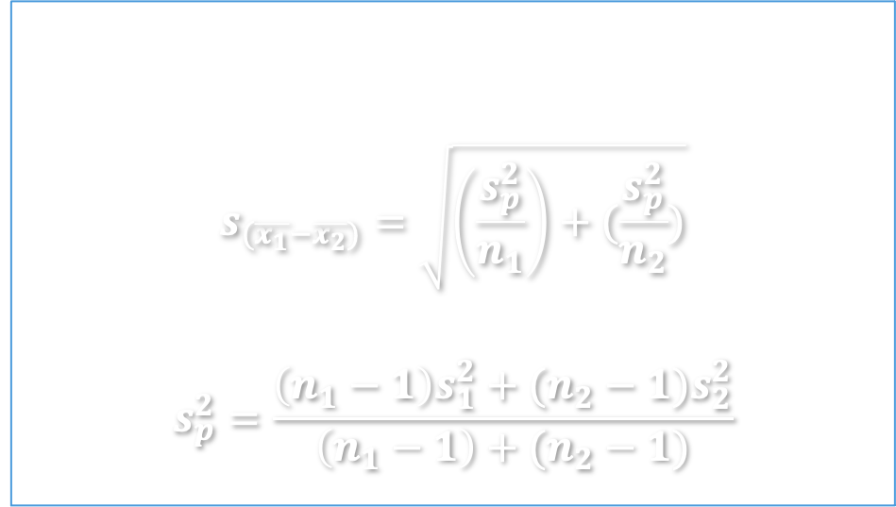
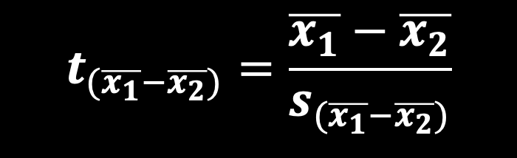
Compute t-score: two-means t-test
Compare test statistics $t$-score to critical value ($t_{df,α}$)
Two means t-test
t-score is calculated by:
SE based on sample SDs
$$s_{(\overline{x_{1}}−\overline{x_{2}})}=\sqrt{\left(\frac{s_{p}^{2}}{n_{1}}\right)+(\frac{s_{p}^{2}}{n_{2}})}$$
$$s_{p}^{2}=\frac{\left(n_{1}−1\right)s_{1}^{2}+(n_{2}−1)s_{2}^{2}}{\left(n_{1}−1\right)+(n_{2}−1)}$$
$$t_{(\overline{x_{1}}−\overline{x_{2}})}=\frac{\overline{x_{1}}−\overline{x_{2}}}{s_{(\overline{x_{1}}−\overline{x_{2}})}}$$

Slide 20


Compute t-score: two-means t-test
Compare test statistics $t$-score to critical value ($t_{df,α}$)
Two means t-test with same sample sizes ($n_{1}=n_{2}=n$)
t-score is calculated by:
$$t_{(\overline{x_{1}}−\overline{x_{2}})}=\frac{\overline{x_{1}}−\overline{x_{2}}}{s_{(\overline{x_{1}}−\overline{x_{2}})}}$$
When $n_{1}=n_{2}=n$, SE based on equal size samples can be simplified as:
$$s_{(\overline{x_{1}}−\overline{x_{2}})}=\sqrt{\left(\frac{s_{1}^{2}}{n}\right)+\left(\frac{s_{2}^{2}}{n}\right)}$$

Slide 21

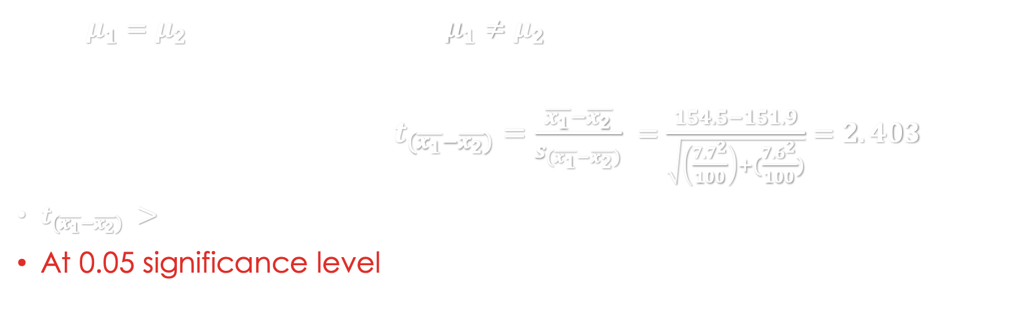
EXAMPLE 3 – two MEAN T-TEST, equal size samples
GRE example: compare GRE verbal test performance by gender for US citizens in 2012 ($α=0.05$)
 | Sample size | Sample Mean | Sample SD
1 - Men | 100 | 154.5 | 7.7
2 - Women | 100 | 151.9 | 7.6
Statement
Sig. level
Calculate
Decide
H₀: $μ_{1}=μ_{2}$ vs H₁: $μ_{1}≠μ_{2}$. ← Two-tailed t-test
Df = (100-1) + (100-1), critical value ${t_{critical}=±t}_{198,0.05}= ±1.960$
t-score for sample mean: $t_{(\overline{x_{1}}−\overline{x_{2}})}=\frac{\overline{x_{1}}−\overline{x_{2}}}{s_{(\overline{x_{1}}−\overline{x_{2}})}} =\frac{154.5−151.9}{\sqrt{\left(\frac{7.7^{2}}{100}\right)+(\frac{7.6^{2}}{100})}}=2.403$
$t_{(\overline{x_{1}}−\overline{x_{2}})} >t_{critical}$ , falls in critical region.
At 0.05 significance level we reject the null hypothesis that there’s no gender difference in GRE verbal test performance for US citizens.
Notes:
Data made up basted on ETS 2012 report https://www.ets.org/s/gre/pdf/snapshot.pdf

Slide 22

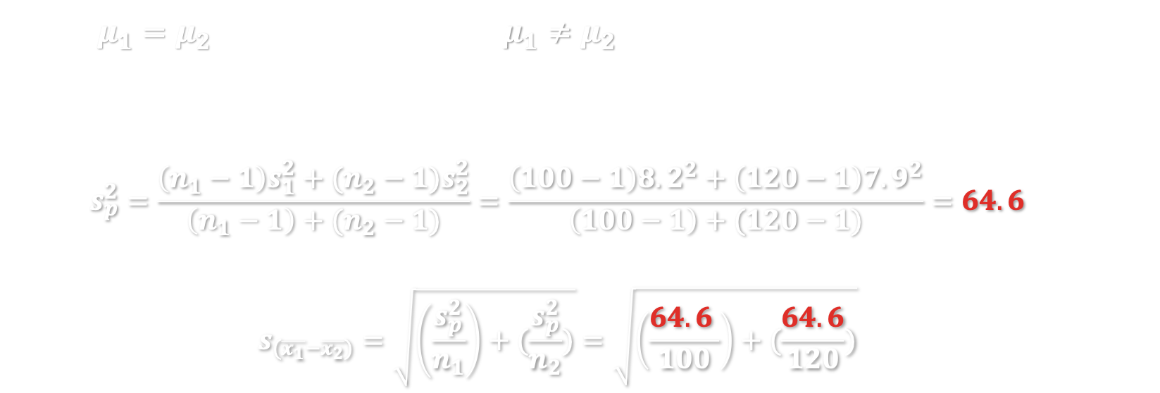
EXAMPLE 3 – two MEAN T-TEST, UNequal size samples
GRE example: compare GRE verbal test performance by gender for non-US citizens in 2012 ($α=0.05$)
 | Sample size | Sample Mean | Sample SD
1 - Men | 100 | 145.9 | 8.2
2 - Women | 120 | 146.5 | 7.9
Statement
Sig. level
Calculate
Decide
H₀: $μ_{1}=μ_{2}$ vs H₁: $μ_{1}≠μ_{2}$. ← Two-tailed t-test
Df = (100-1) + (120-1), critical value ${t_{critical}=±t}_{218,0.05}= ±1.960$
For unequal sample size, weighted average of variance
$$s_{p}^{2}=\frac{\left(n_{1}−1\right)s_{1}^{2}+(n_{2}−1)s_{2}^{2}}{\left(n_{1}−1\right)+(n_{2}−1)}=\frac{\left(100−1\right)8.2^{2}+\left(120−1\right)7.9^{2}}{\left(100−1\right)+(120−1)}=64.6$$
So standard error
$$s_{(\overline{x_{1}}−\overline{x_{2}})}=\sqrt{\left(\frac{s_{p}^{2}}{n_{1}}\right)+(\frac{s_{p}^{2}}{n_{2}})}=\sqrt{\left(\frac{64.6 }{100}\right)+(\frac{64.6}{120})}$$
Notes:
Data made up basted on ETS 2012 report https://www.ets.org/s/gre/pdf/snapshot.pdf

Slide 23
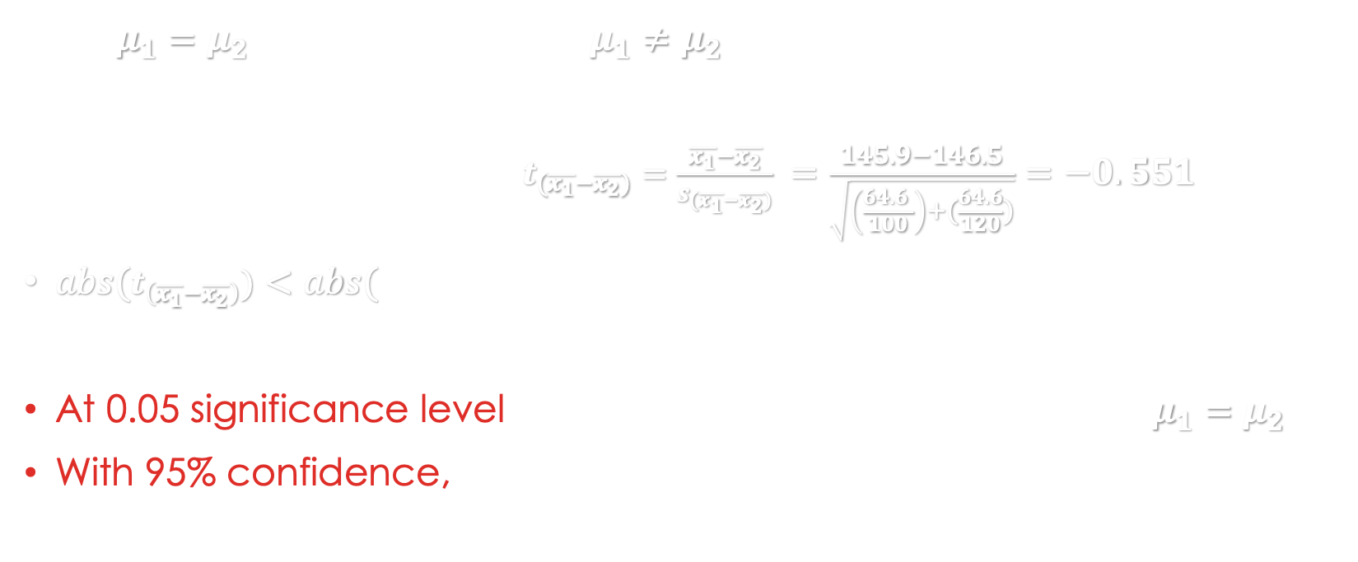

EXAMPLE 3 – two MEAN T-TEST, UNequal size samples
GRE example: compare GRE verbal test performance by gender for non-US citizens in 2012 ($α=0.05$)
H₀: $μ_{1}=μ_{2}$ vs H₁: $μ_{1}≠μ_{2}$. ← Two-tailed t-test
Df = (100-1) + (120-1), critical value ${t_{critical}=±t}_{218,0.05}= ±1.960$
t-score for sample mean: $t_{(\overline{x_{1}}−\overline{x_{2}})}=\frac{\overline{x_{1}}−\overline{x_{2}}}{s_{(\overline{x_{1}}−\overline{x_{2}})}} =\frac{145.9−146.5}{\sqrt{\left(\frac{64.6 }{100}\right)+(\frac{64.6}{120})}}=−0.551$
$abs(t_{\left(\overline{x_{1}}−\overline{x_{2}}\right)})<abs(t_{critical})$ , does not fall in critical region.
At 0.05 significance level we fail to reject the null hypothesis $μ_{1}=μ_{2}$.
With 95% confidence, we conclude that men and women performs similarly well in GRE verbal test among non-US citizens in 2012.
Statement
Sig. level
Calculate
Decide
Notes:
Data made up basted on ETS 2012 report https://www.ets.org/s/gre/pdf/snapshot.pdf

Slide 24

In-class exercise
Test score example
The school want to know whether students intended for social science majors has higher GRE verbal test scores than those intended for natural sciences. You surveyed 100 students and get data below:
Question
Calculate 95% confident interval for mean score of students with intended major in social science. (slide 10)
State and test your hypothesis at significant level $α$= 0.05. (slide 20-21)
Type your answer in Carmen – Lab attendance
Intended major | # students | Sample mean | Sample SD
Social science | 50 | 155.1 | 8.4
Natural science | 50 | 149.9 | 9.2

Slide 25

In-class exercise
Test score example
The school want to know whether 2020 class out-performs 2019 class in GRE verbal test. 2019 class had mean score of 148.5. You took a sample of n=16 students, and get their scores:
Question
Calculate 95% confident interval for mean score of class 2020.
Test your hypothesis that 2020 class out-performed 2019 class, at significant level $α$= 0.05.
158.2 | 137.4 | 171.9 | 150.9 | 166.1 | 156.5 | 129.4 | 145.6
147 | 144.3 | 140 | 141.2 | 143.1 | 147.3 | 158.4 | 145.7

